Slide 1

JAVA CAPSTONE PROJECT Smart House: Simulation of the Energy supply and consumption
Group-B
Adijat Ajoke Sulaimon
Ammar Haziq Bin Mohd Halim
RoamilKumar Kachchhi
Eze Michael

Slide 2

Agenda
Overview
Roles distribution in the team
Requirements to the system
UML class diagram and component diagram
Management I/O in the system
User interfaces
Concurrency
Results of the Unit Test of the System

Slide 3
Overview
Develop a Smart House simulation system.
Simulate energy supply and consumption.
Provide an interactive user interface for managing smart devices and energy sources.
Logs, exception handling, and unit tests.

Slide 4
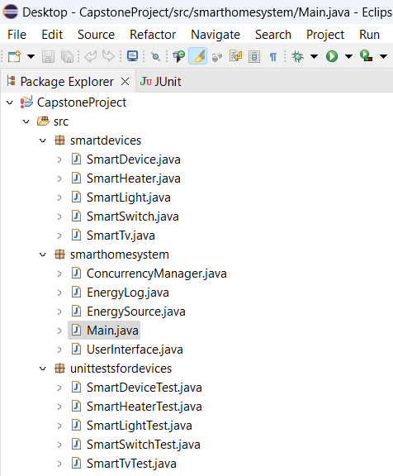
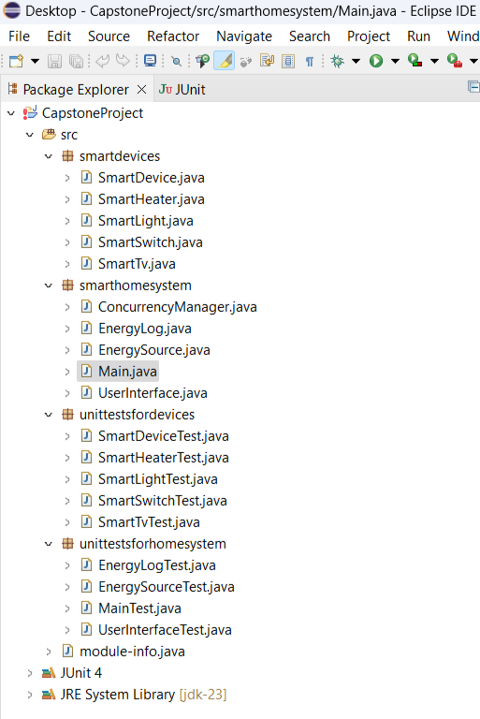

Slide 6
Roles Distribution
Worked on User interface: Adijat Ajoke Sulaimon
Worked on Concurrency Simulation: Ammar Haziq Bin Mohd Halim
Worked on Unit testing and exception Handling : Eze Michael
Worked on Saving Log Info :RoamilKumar Kachchhi

Slide 7
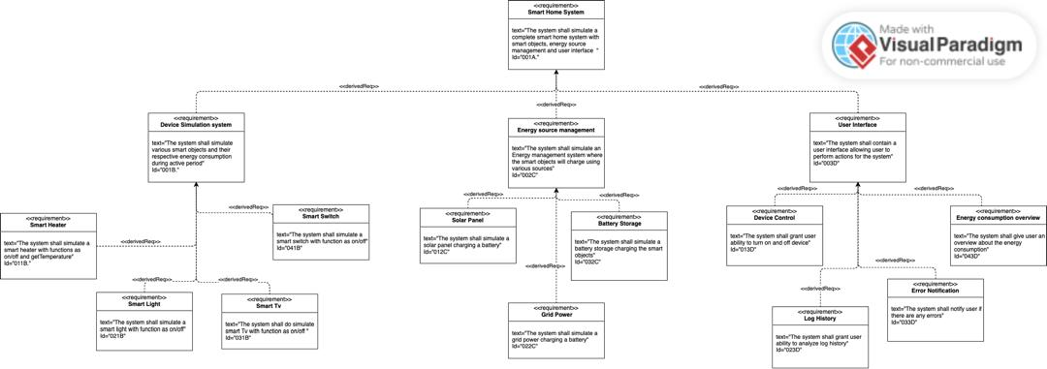

Slide 8
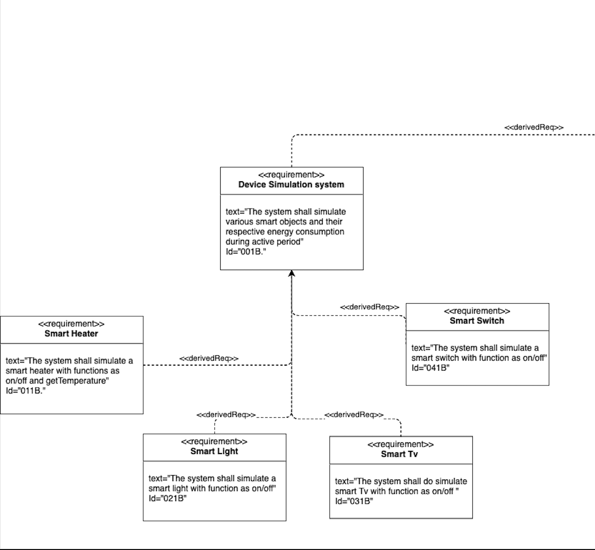
Requirements Diagram 2

Slide 9
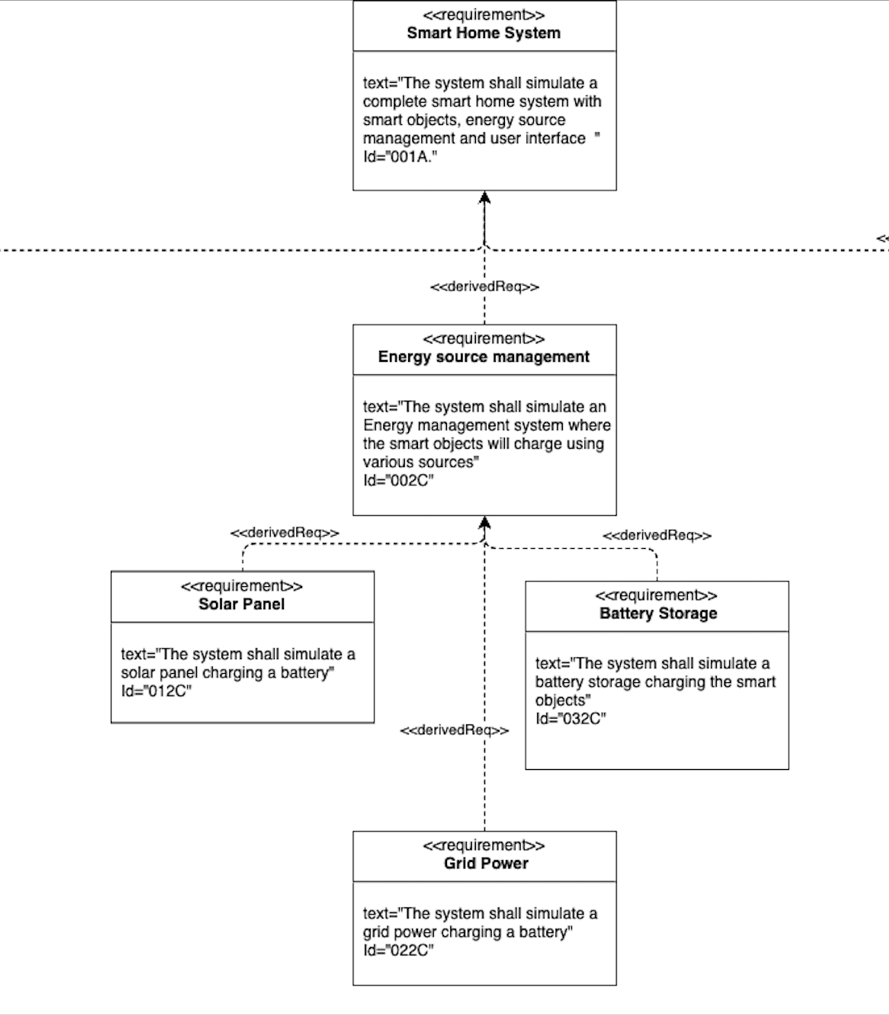

Slide 10
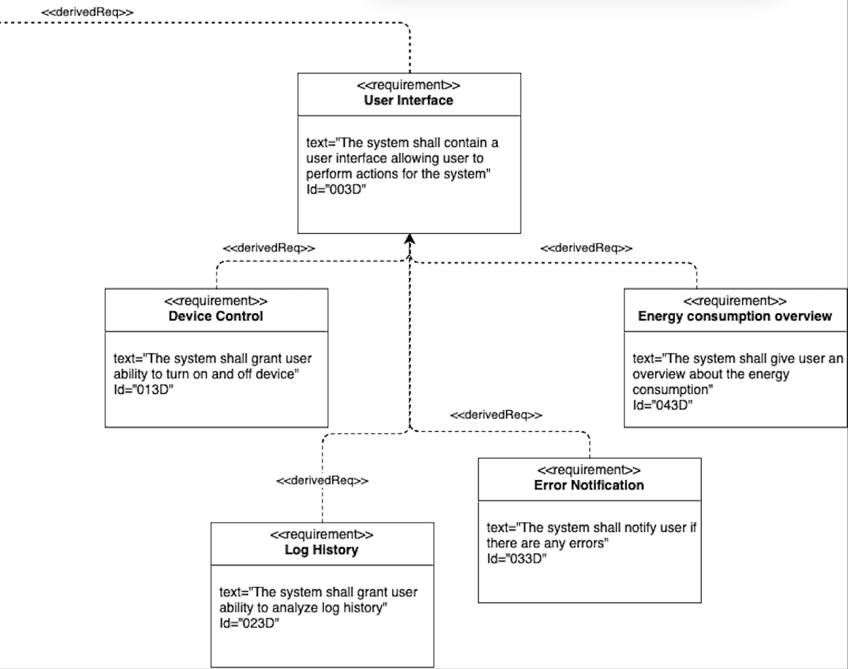

Slide 11
System Requirements
Functional Requirements:
Simulate energy flow between devices and sources.
Provide a user interface to control smart devices.
Save Log system actions.
Unit test and Exception Handling.

Slide 12
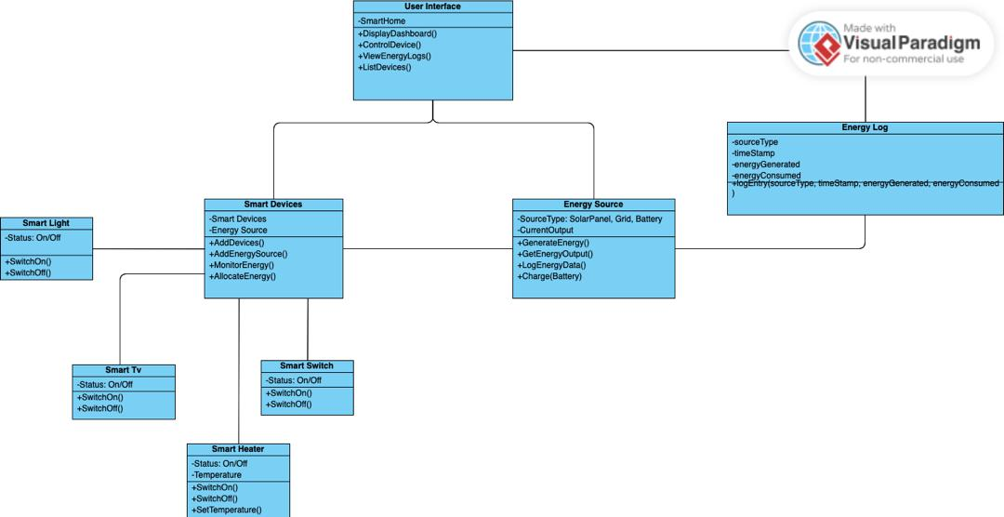
UML Class Diagram

Slide 13
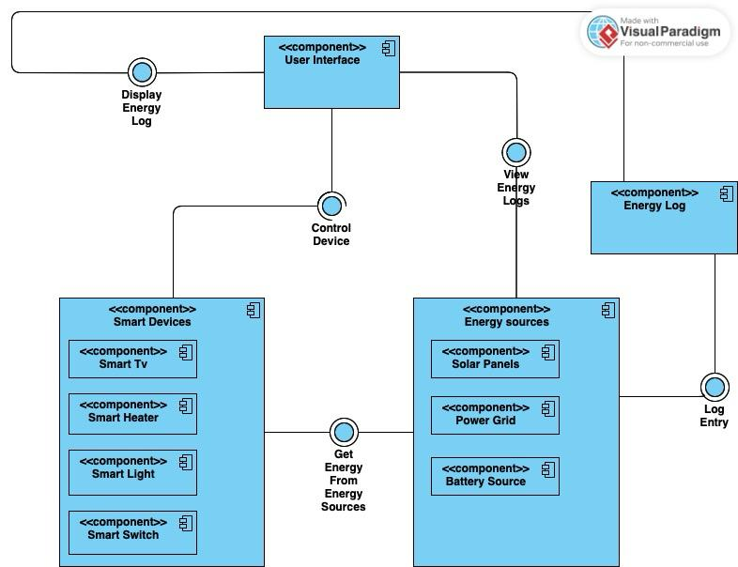
Component Diagram

Slide 14
Concurrency Simulation
Multithreading Implementation:
Separate threads for:
Energy consumption from Smart devices.
Energy deduction from energy manager.
Example:
Battery level updates every second in parallel with user actions.

Slide 15

Management I/O
Input:
Device ON/OFF commands.
Initial energy and device configurations.
Output:
Energy flow visualization.
Device statuses.
System logs (e.g., "Light turned ON").

Slide 16
User Interfaces
User Interfaces: Console-Based
Overview:
The project uses a console-based interface for simplicity and direct interaction with the system.
Users can input commands to control smart devices, simulate energy sources, and manage consumption.
Features:
Device Control:
Turn ON/OFF smart objects (e.g., lights, heater, fan) through textual commands.
Energy Management:
Monitor energy usage and battery status in the console output.
***Logs:
***Display real-time system logs for user actions and energy flow.

Slide 17
Unit Test Results
Tests Conducted:
Device toggling functionality.
Energy consumption and supply simulations.
Exception handling tests for invalid inputs.
Results:
All tests passed successfully.

Slide 18
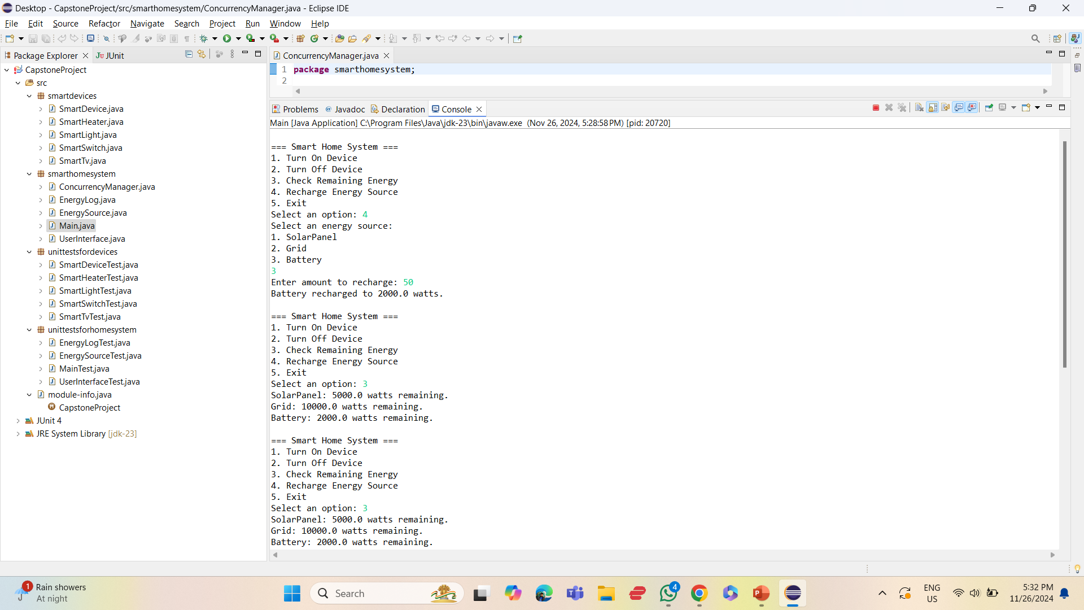
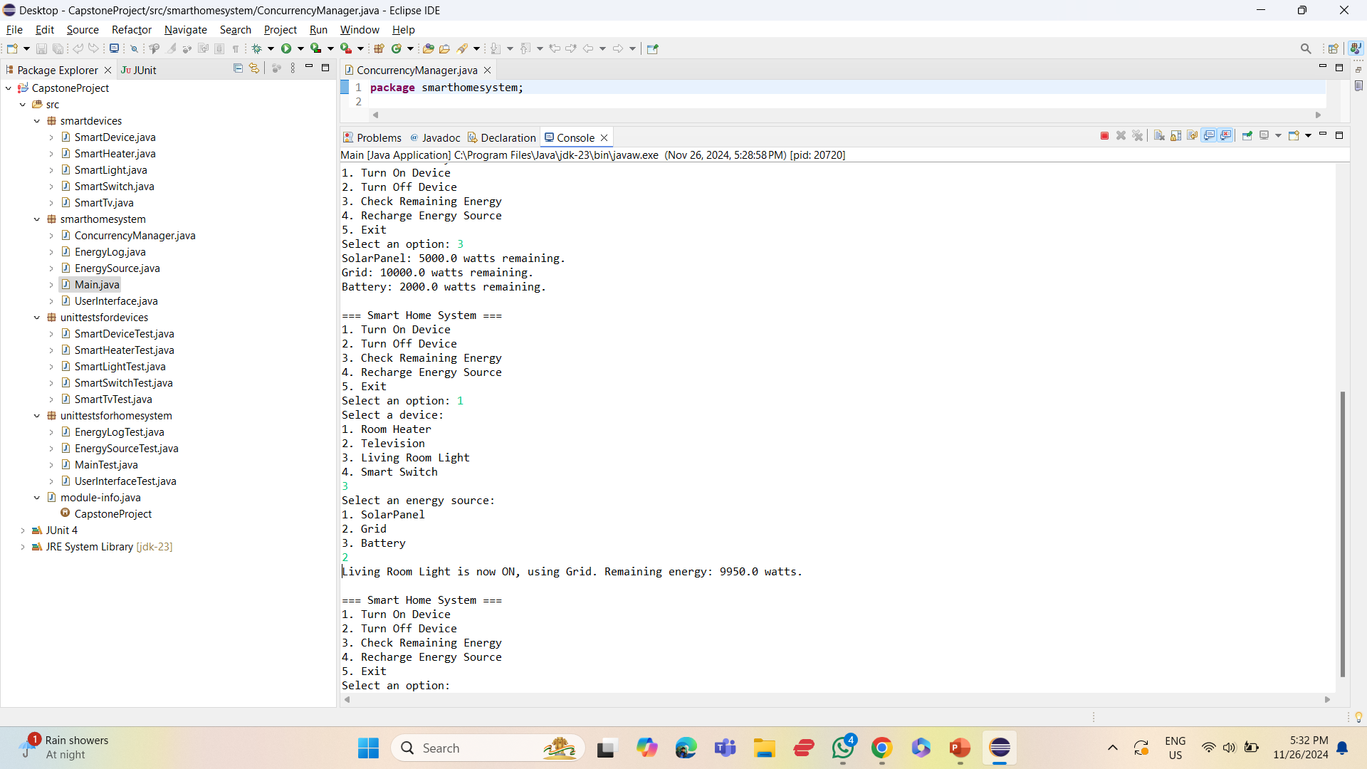

Slide 19

Demonstration
GitHub Link:- https://github.com/Group-B-Java/Java_project/tree/main

Slide 20

Thank you

